Slide 1






Netflix Movie Recommendation
Team Members:
Abhijit Kunjiraman
Dipti Dubey
Merwin Roy
Raveena Yadav

Slide 2
Abstract
This project implements content-based and collaborative filtering recommender systems approach to implement an algorithm that provides relevant movie recommendations to users with the help of Netflix and Movie lens datasets from Kaggle, as well as sentiment analysis on reviews of movies recommended by the system.
The project report provides a summarized description of the project “Netflix Movie Recommender System”, models used to implement the recommender system, sentiment analysis and conclusions derived through it using different metrics obtained.

Slide 3
SUMMARY
In this project, we have focused primarily on Netflix platform which makes great use of recommender systems to suggest movies and shows to users based on variety of factors such as genres, ratings, interests of similar users, viewership patterns etc. Taking Netflix movie dataset into consideration, we have implemented different recommendation engines and sentiment analysis models to suggest similar movies to users along with their reviews.
For the content-based recommendation, the system makes use of cosine similarity metric to measure the similarity between movies from datasets based on different features such as movie genre, actors, and director names.
For collaborative filtering recommender system, the system makes use of Pearson’s correlation to measure similarity between users.
The system also makes use of sentiment analysis, a natural language processing technique (NLP) technique to analyze and identify states and subjective information of reviews associated with movies recommended to users by the recommender system. The sentiment analysis has been implemented using CountVectorizer, CNN (Convolutional Neural Network) Model and LSTM-CNN model which combines the traditional neural networks CNN and LSTM (Long Short-Term Memory) model.

Slide 4

GOALS
The goal of the project is to study and compare different recommender systems (collaborative and content based) as well as different sentiment analysis models (CountVectorizer, CNN, LSTM-CNN) through metrics obtained and eventually provide near perfect movie recommendation results to users with reviews obtained through the process of sentiment analysis.

Slide 5

MODELS
Recommender Systems:
Content Based Filtering using Cosine Similarity Measure
Collaborative Filtering using Pearson’s Correlation Coefficient (PCC) Measure
Sentiment Analysis:
Multinomial Naïve Bayes
CNN Model (Convolutional Neural Network )
CNN-LSTM Model (Convolutional Neural Network + Long Short-Term Memory)

Slide 6
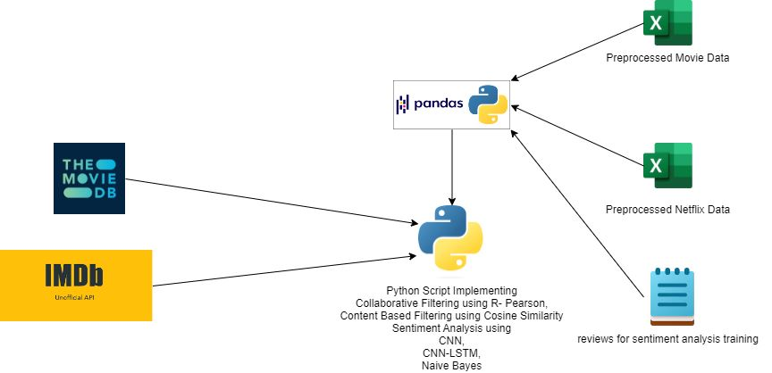
SYSTEM ARCHITECTURE

Slide 7

PACKAGES
numpy
pandas
matplotlib
seaborn
scikit-learn
lxml
TMDb
tmdbv3api
BeautifulSoup4
nltk
scikit-plot
cinemagoer
keras
tensorflow

Slide 8
CONCLUSION
After a comparative study on the models above, we conclude that the classification model using the Convolutional Neural Network (CNN) is the best model with an approx. accuracy score of 99.13 %.
MODEL | ACCURACY (%)
Multinomial Naïve Bayes | 97.471
CNN | 99.23
CNN-LSTM | 98.55

